Slide 1
HP
RC_1779455352573_IMWV
Shivaay Infotech
📍 Shop no. 12 upper floor, sukhmani tower,kocher market ludhiana
☎ 9709727000
📅 Visit date: 2026-05-22
Client: HP
360 Degree Marketing · Recce Report

Slide 2
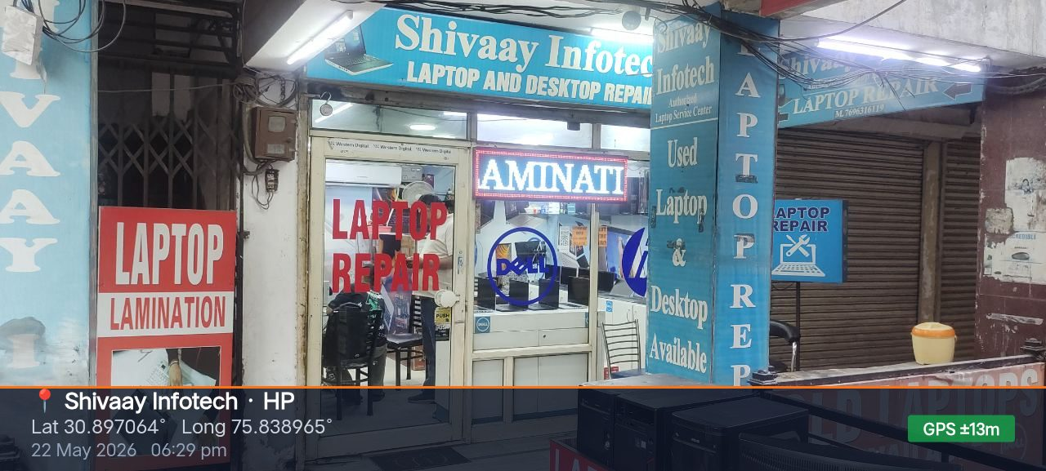
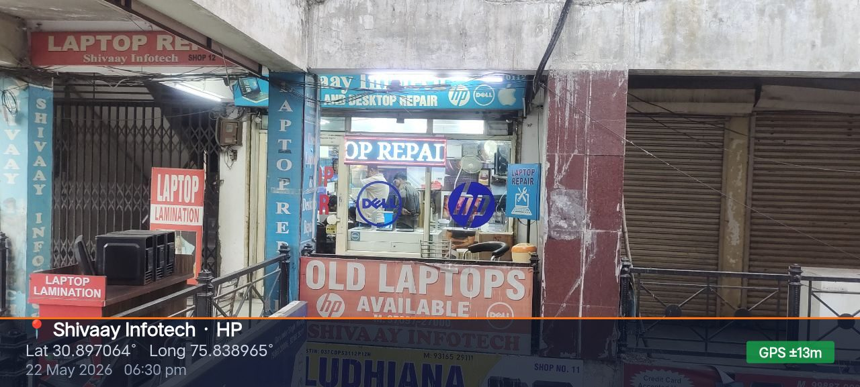
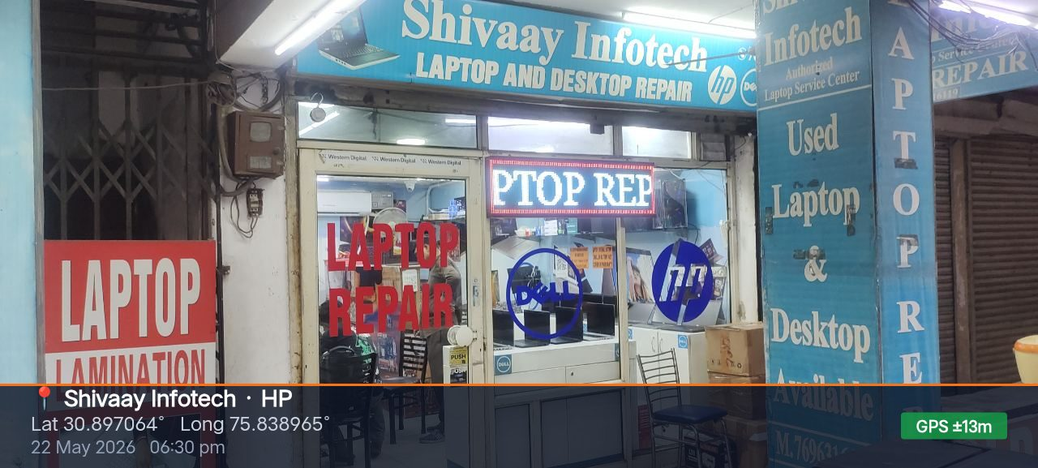
Front View
Shivaay Infotech · HP

Slide 3
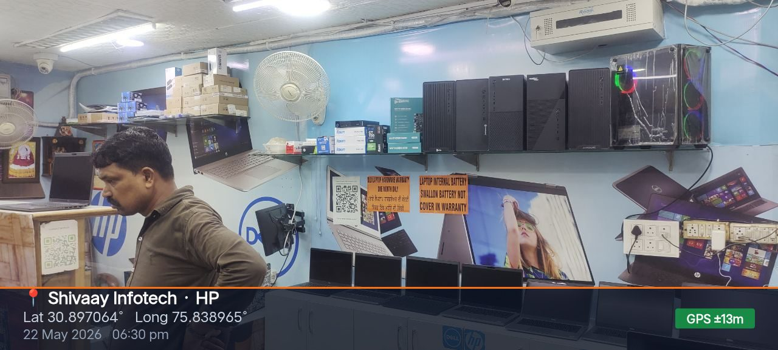
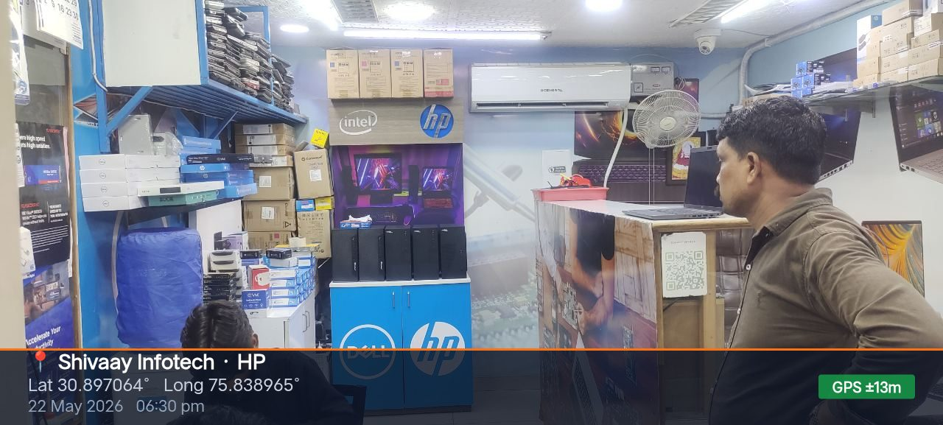
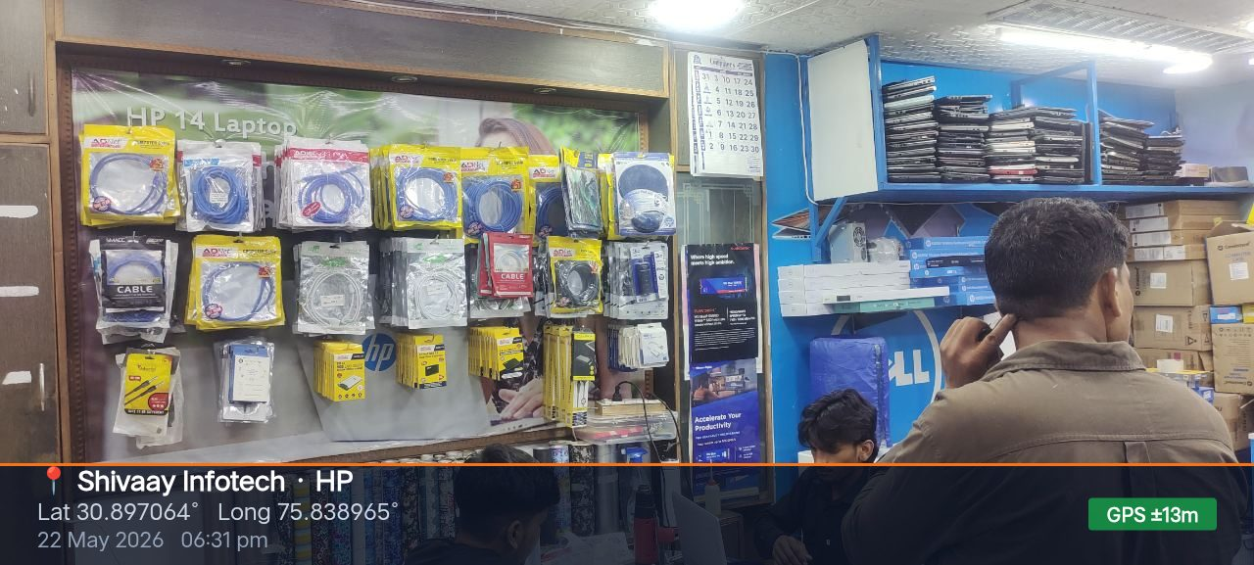
Inside View
Shivaay Infotech · HP

Slide 4
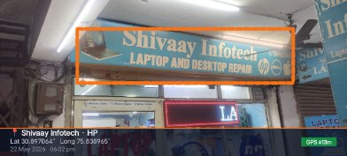
Glow Sign Board
139" × 18" — 1 Nos
Shivaay Infotech · HP

Slide 5
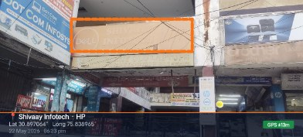
Glow Sign Board
179" × 67" — 1 Nos
Shivaay Infotech · HP

